Slide 1




Strategic Acquisition Analysis: Should Larsen & Toubro acquire KEC International?
Strategic Acquisition Analysis
Larsen & Toubro – KEC International
Presented By:
Sanjana Stephen

Slide 2



INVESTMENT THESIS
Acquisition strengthens L&T’s position in EPC and infrastructure segments
Enhances global footprint, particularly in transmission and railways
Synergies expected through operational efficiency and scale advantages
Transaction expected to be earnings accretive

Slide 3
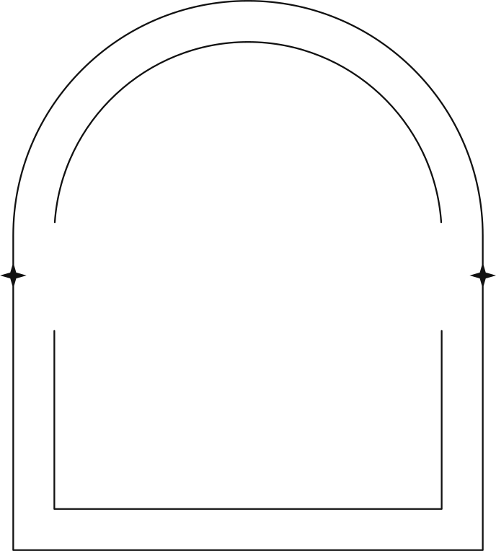

INDUSTRY OVERVIEW
Indian infrastructure sector projected to grow at 8–10% CAGR
Government focus on capex, railways, and power transmission
Increasing demand for integrated EPC solutions
Increasing demand for integrated EPC solutions

Slide 4



ACQUIRER OVERVIEW
Leading EPC and infrastructure company in India
Strong order book and diversified project portfolio
Larsen & Toubro
Presence across engineering, construction, and technology
Robust balance sheet supporting acquisitions

Slide 5

Global EPC player focused on power transmission and railways
Strong international presence
TARGET OVERVIEW
KEC International
Growing order book with diversified projects
Stable revenue growth and improving margins

Slide 6
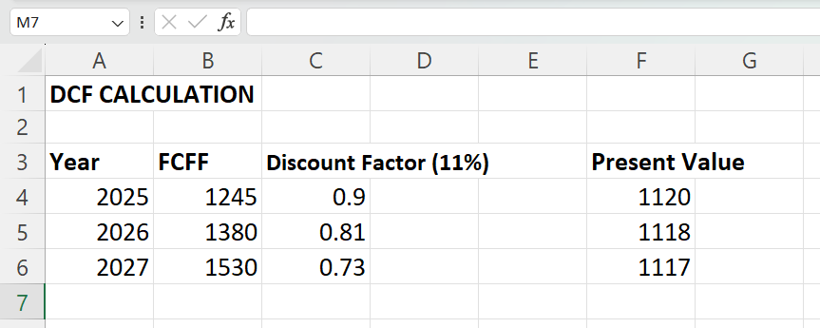
VALUATION
DCF Valuation
Enterprise Value: ₹30,000 Cr (approx.)
Comparable Valuation
EV/EBITDA Multiple: ~11x
Implied Value: ₹22,000 Cr
Valuation Range: ₹22K – ₹30K Cr
Key Assumptions:
WACC: 11%
Terminal Growth: 4%
Tax: 25%
Enterprise Value: ₹30,000 Cr

Slide 7
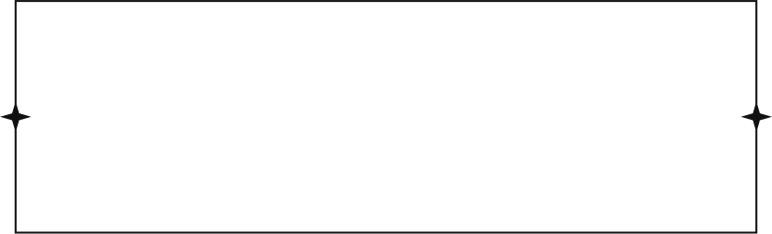

SYNERGIES
Revenue Synergies
Cost Synergies
Cross-selling opportunities across infrastructure projects
Procurement efficiencies
Expansion into international markets
Shared operational capabilities
Estimated revenue uplift: ~5%
Estimated cost savings: ~2%

Slide 8
Transaction structured as 60% cash, 40% debt
L&T’s balance sheet supports partial leverage
Efficient capital deployment with manageable risk
DEAL STRUCTURE

Slide 9
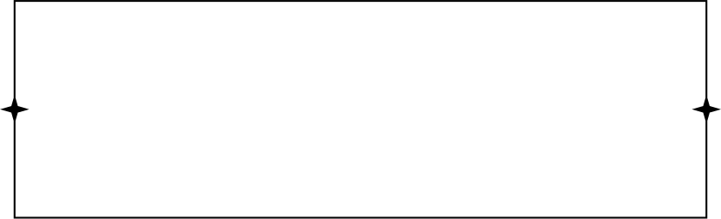
RISKS
Integration challenges across operations
Execution delays in large infrastructure projects
Increase in leverage due to debt financing
Regulatory and approval risks

Slide 10
RECOMMENDATION
Strong strategic alignment
Value-accretive transaction
Long-term growth potential

